Slide 1





Next Gen Employability Program
NEXT GEN EMPLOYABILITY PROGRAM
Creating a future-ready workforce
Team Members
College Name
Student Name :SANTHOSH RAJ S
Student ID :au814721104048
SRM TRP Engineering college
Notes:
1

Slide 2

Next Gen Employability Program
CAPSTONE PROJECT SHOWCASE
Project Title
Notes Sharing Web Application using Django Framework
Abstract | Problem Statement | Project Overview | Proposed Solution | Technology Used | Modelling & Results | Conclusion

Slide 3
Next Gen Employability Program
Abstract
Building a modern web application can be both complex and rewarding. In this project, we explore how to create a full-stack application using React (for the front end) and Django (for the back end). Our focus is on building a simple yet powerful note-taking app that allows users to store, update, and delete their notes. The key steps include setting up the development environment, creating APIs with Django, building the front end with React, and ensuring deployment security and performance
Source :

Slide 4
Next Gen Employability Program
Problem Statement
In traditional educational environments, sharing files between students and teachers can be inefficient and cumbersome. Students often need to submit assignments or access resources, while teachers need to distribute materials and provide feedback. However, existing methods, such as email or physical submissions, lack organization and can lead to confusion or lost files.To address these challenges, this project aims to develop a web application that enables seamless file sharing between students and teachers. The application will provide a centralized platform for uploading, downloading, and managing files, enhancing collaboration and efficiency within educational communities.
Source :

Slide 5
Next Gen Employability Program
Project Overview
Our goal is to build a simple yet powerful note-taking API that allows users to store, update, and delete their notes. Here are the key steps we’ll cover:
1.Setting Up the Development Environment:
We start by creating a new Django project within a virtual environment.
Virtual environments are crucial for maintaining stability, compatibility, and reproducibility in Python projects.
2.Creating the API:
We create a Django app specifically for our API.
The concept of our app is similar to the regular note-taking apps found on modern phones, allowing users to manage their notes in a CRUD-ely (Create, Read, Update, Delete) manner.
3.Important Topics Covered:
Models: Defining the data structure for notes.
Views: Handling requests and responses.
URL Patterns: Setting up URL paths for the API.
By following these steps, developers can build a robust and secure note-taking API using Django, ensuring efficient management and access to user notes while adhering to best practices in web development.

Slide 6
Next Gen Employability Program
Proposed Solution
Our goal is to create a robust note-taking web application that allows users to manage their notes efficiently. Here’s how we’ll approach it:
.
1.Setting Up the Project:
Create a new Django project within a virtual environment.
Install Django using pip install django.
Start the development server with python manage.py runserver.
2.Creating the Note-Taking App:
Generate a Django app specifically for the note-taking functionality using python manage.py startapp notes.
Define a model for notes in the models.py file. Include fields for title, content, creation date, and modification date.
3.Views and URL Patterns:
Implement views for creating, editing, and displaying notes.
Set up URL patterns to handle different endpoints (e.g., note creation, editing, deletion).
4.User Authentication and Registration:
Integrate Django’s authentication system.
Allow users to create accounts, log in, and log out.
Ensure that only authenticated users can access note-related features.
Source :

Slide 7


Next Gen Employability Program
Technology Used
Front-end
Back-end
Source :

Slide 8
Next Gen Employability Program
Modelling & Results
Model Structure:
1.User Model:
Fields: username, email, password (hashed), date joined, etc.
2.Note Model:
Fields: title, content, created_at, last_updated_at, owner (ForeignKey to User), etc.
Expected Result:
1.User Authentication:
Users can sign up, log in, and log out securely.
Passwords are hashed for security.
2.Note Management:
Users can create, read, update, and delete their own notes.
Each note is associated with the user who created it.
3.API Endpoints:
/api/notes/: CRUD endpoints for managing notes.
/api/auth/signup/: Endpoint for user registration.
/api/auth/login/: Endpoint for user login and token generation.
/api/auth/logout/: Endpoint for user logout.

Slide 9
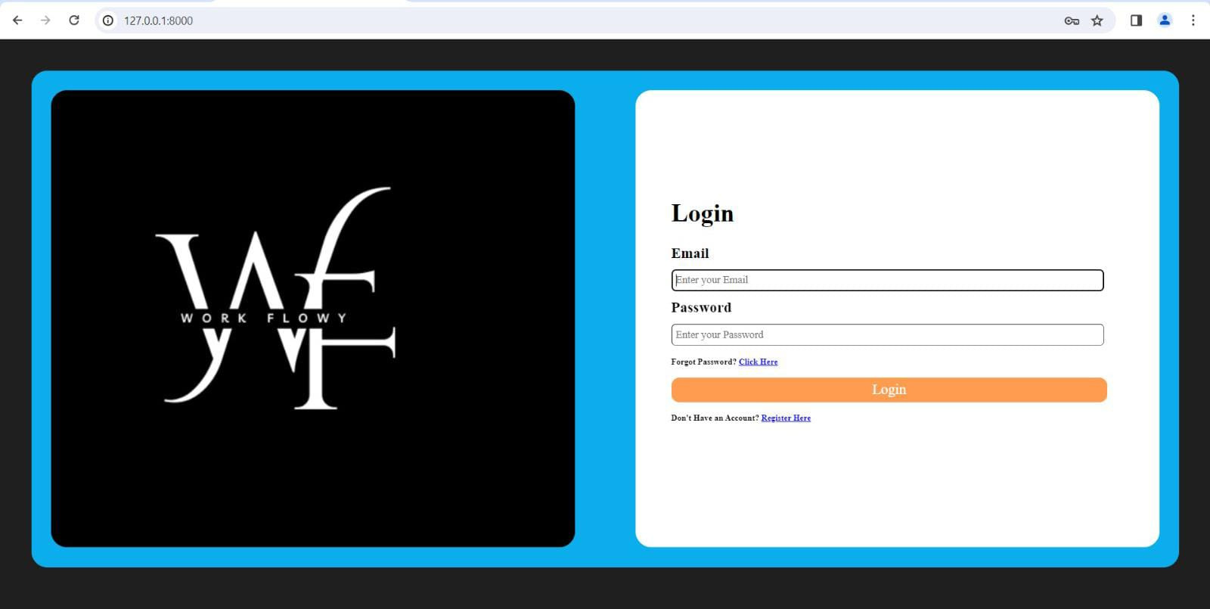
Next Gen Employability Program
Login page

Slide 10
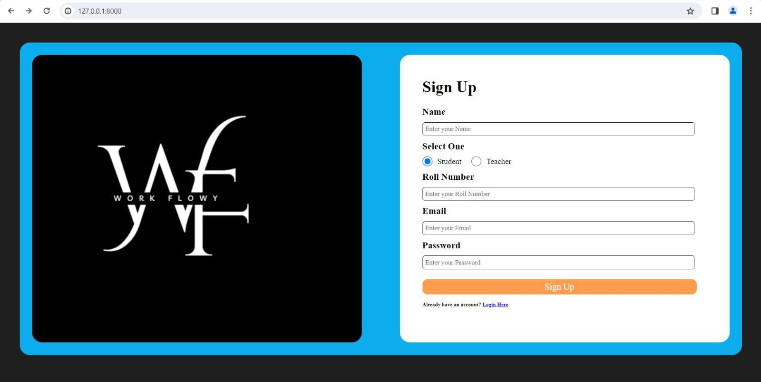
Next Gen Employability Program
Sign up page

Slide 11
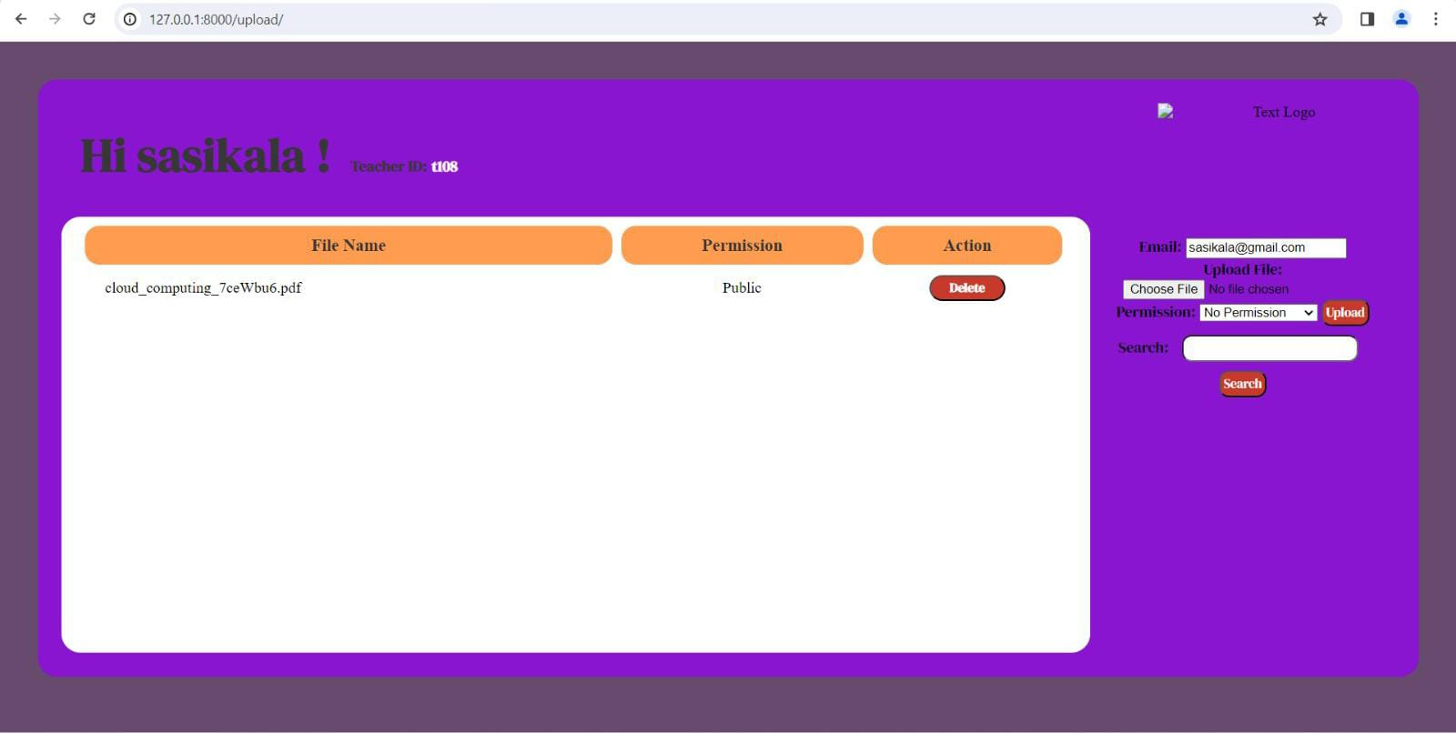
Next Gen Employability Program
Teacher’s home page

Slide 12
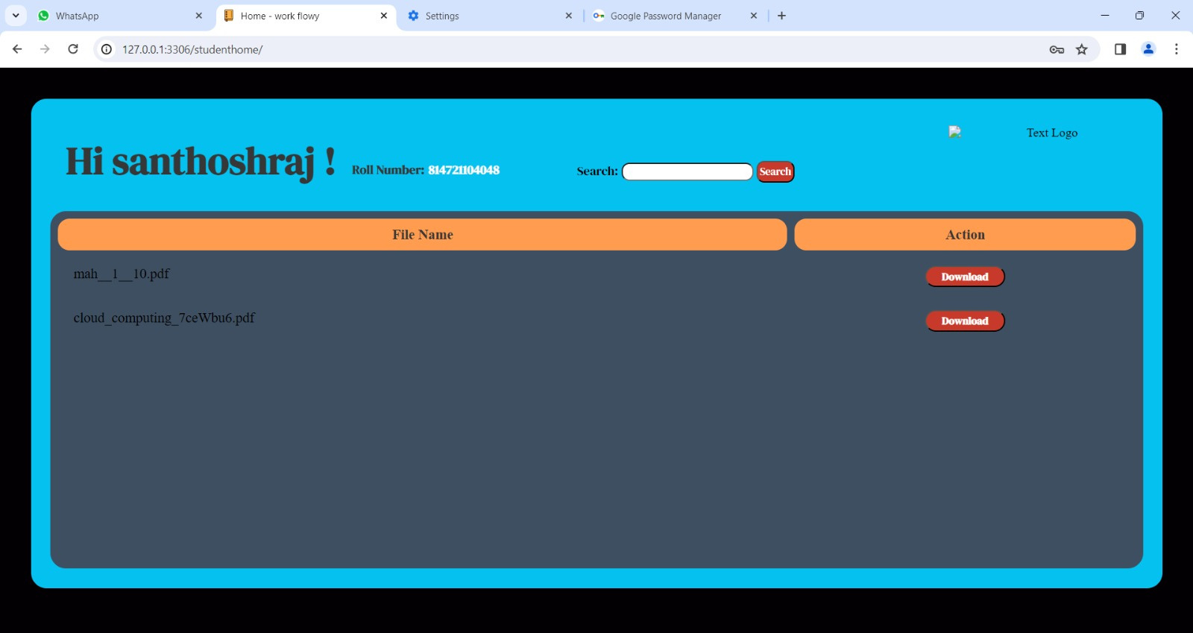
Next Gen Employability Program
Student’s home page

Slide 13
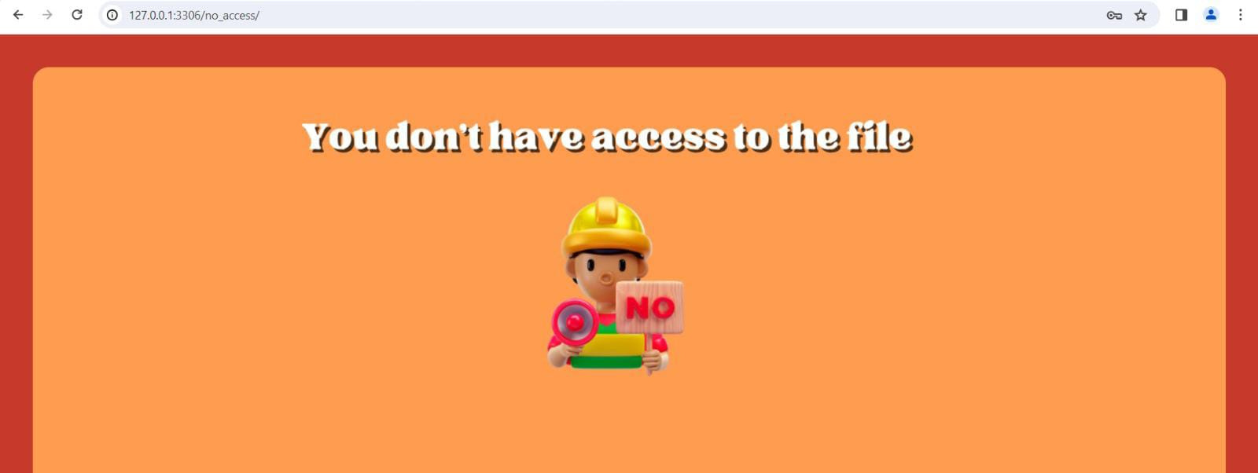
Next Gen Employability Program
No access

Slide 14
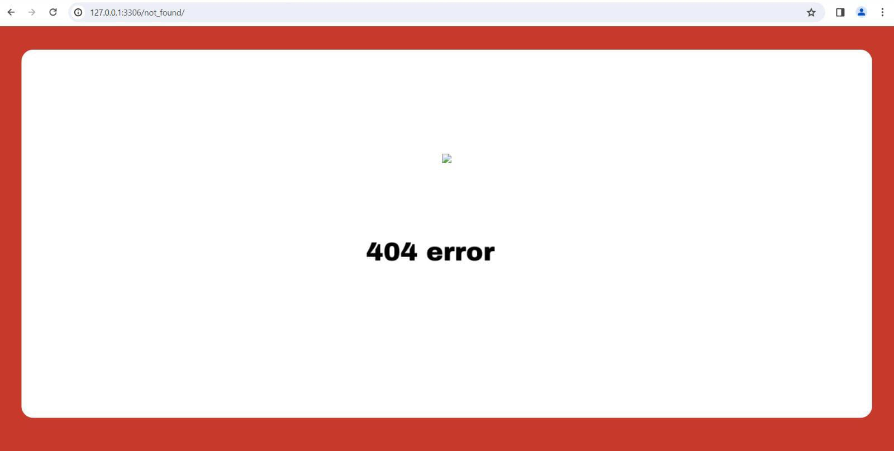
Next Gen Employability Program
404 Error

Slide 15
Next Gen Employability Program
Future enhancement
Here are some potential future enhancements for your NotesSharing web application built with React and Django:
1.User Profiles and Authentication:
Implement user authentication using JWT (JSON Web Tokens) or OAuth.
Allow users to create profiles, customize their settings, and manage their notes securely.
2.Collaboration Features:
Enable collaboration by allowing users to share notes with others.
Implement real-time updates when multiple users are editing the same note.
3.Rich Text Editor:
Enhance the note-taking experience by integrating a rich text editor (e.g., Quill, Draft.js).
Support formatting (bold, italic, bullet points) and attachments (images, files).
4.Tags and Categories:
Allow users to categorize their notes using tags or folders.
Implement a search feature based on tags or keywords
Source :

Slide 16
Next Gen Employability Program
Conclusion
In summary, the NotesSharing web application is a full-stack Django project designed to facilitate seamless sharing and management of notes. Through careful setup of the development environment, creation of dedicated API endpoints, implementation of crucial features like models for data structure, views for handling requests, and URL patterns for routing, the app ensures efficient note-taking functionality. Additionally, integration of JWT authentication enhances security, enabling users to authenticate and access their notes with confidence. Overall, the project delivers a user-friendly and secure platform for collaborative note-taking, catering to modern digital needs.
Source :

Slide 17
Next Gen Employability Program
Thank You!
Notes:
Thank You !!

